Slide 1
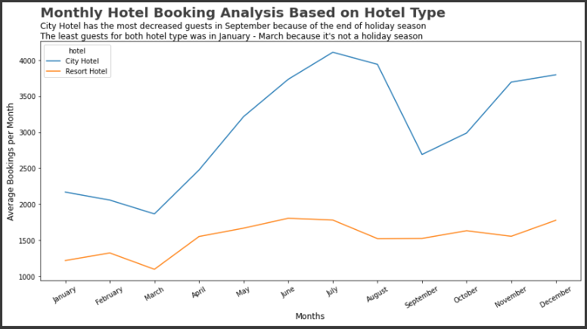
Monthly Hotel Booking Analysis Based on Hotel Type
2
3
4
Explaination :
Least bookings, not holiday season
Most bookings, holiday season
Decreasing total bookings, end of holiday season
Going up again, holiday season
1

